Slide 1
Introduction to Predictive Modelling in R
Use case: Fraud Detection Research
Anil Kumar Madishetty
December 2019

Slide 2
What is Predictive Modelling?
Purpose of Predictive Modelling
Types of Predictive Models

Slide 3
What is Predictive Modelling?
Using historical data to predict future events
Capturing important trends
Using current data to predict what will happen next
Suggest actions to take for optimal outcomes
Using statistics to predict outcomes

Slide 4
Purpose of Predictive Modelling
To name a few ….
To solve a business problem
Ability to identify business opportunities
To come up with actionable insights
Forecast business trend
Identify useful resource
Identify prospective customers
Direct useful resource to the right path
Price Optimization
Make predictions
To improve sales, revenue and profit margin
To improve cross-product sales
Detect fraud
Avoid risk

Slide 5
Types of Predictive Models
Linear Regression
Robust & Resistant Regression
Binomial Regression
Polynomial Regression
Multinomial Logistic Regression
Decision Trees
Random Forest
Naïve Bayes
Support Vector Machines
Extreme Gradient Boosting
Principal Component Analysis
K-Nearest Neighbors
Time Series Analysis
Cluster Analysis
Text Analytics
Image Recognition
Neural Networks
Deep Neural Networks
Transfer Learning
Deep Learning

Slide 6
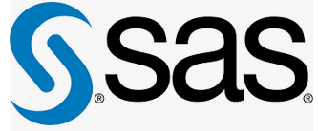





Data Science tools

Slide 7
Step 3:
Analyze Data
Descriptive Statistics
Exploratory Data Analysis
Step 4:
Model Building
Feature Engineering
Train Model
Validate Model
Analyze Data
Step 2:
Load Dataset
Import dataset into R
Data Structure
Load
Dataset
Model
Building
Predictive Modelling in R
Fine Tuning
Step 5:
Fine Tuning
Tuning parameters
Step 1:
Problem Definition
Identifying the core problem
for which the research is
meant for
Problem
Definition

Slide 8

Problem Definition

Slide 9

Problem Definition
The focus of this use case will be the Fraud vs Non-Fraud records
The problem is to predict fraudulent or non-fraudulent objects from a Synthetic Financial Dataset of mobile money transactions generated for fraud detection research
The dataset has more than 10,00,000 observations with 11 variables
The label associated with each record categorized as 0 if the object is a legitimate record and 1 if it is a fraudulent record, so this issue belongs to classification

Slide 10

Packages used in...
library(dplyr)
library(caret)
library(ggplot2)
library(randomForest)
library(Matrix)
library(data.table)
library(magrittr)
library(Metrics)
library(gridExtra)
library(fastDummies)

Slide 11

Load Dataset

Slide 12

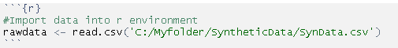
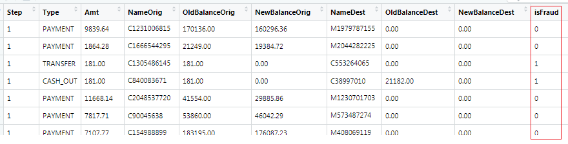
Load Dataset
Importing dataset into R environment

Slide 13

Feature information:
Step - maps a unit of time in the real world. In this case 1 step is 1 hour of time.
Type - CASH-IN, CASH-OUT, DEBIT, PAYMENT and TRANSFER.
Amt - amount of the transaction in local currency.
NameOrig - customer who started the transaction
OldBalanceOrg - initial balance before the transaction
NewBalanceOrig - new balance after the transaction
NameDest - customer who is the recipient of the transaction
OldBalanceDest - initial balance of recipient before the transaction.
NewBalanceDest - new balance of recipient after the transaction.
isFraud - This is the transactions made by the fraudulent agents inside the simulation.
isFlaggedFraud - The business model aims to control massive transfers from one account to another and flags illegal attempts. An illegal attempt in this dataset is an attempt to transfer more than 200.000 in a single transaction

Slide 14
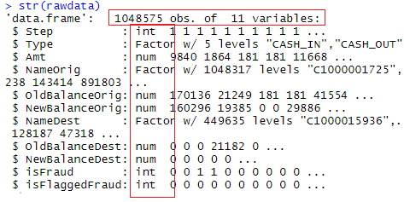
Data structure
Information such as the size of the data set, what the observations and variables represent, types of each variable, etc. are captured in the dataset.

Slide 15

Analyze Dataset

Slide 16
Analyze Dataset
Descriptive Statistics
Exploratory Data Analysis (EDA)

Slide 17

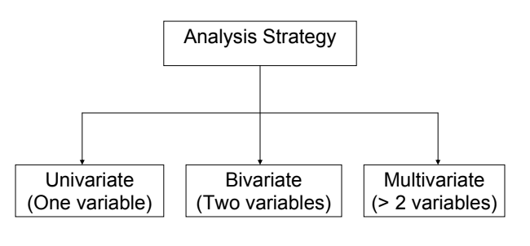
Analyze Dataset
Descriptive Statistics

Slide 18
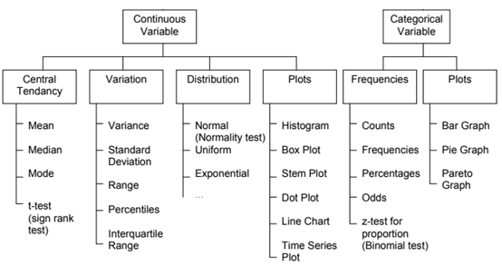
Analyze Dataset
Descriptive Statistics

Slide 19
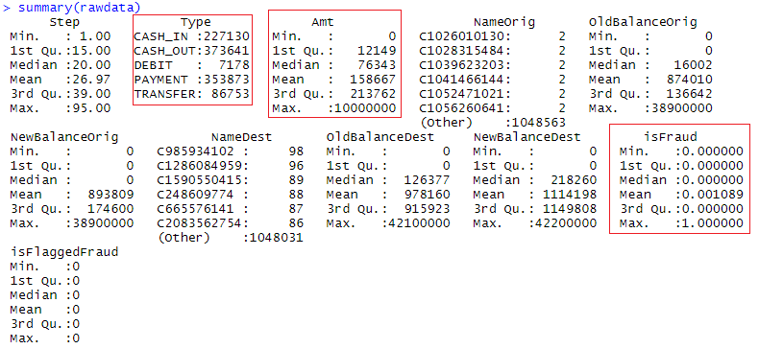
Analyze Dataset
Descriptive Statistics
Statistical summaries

Slide 20
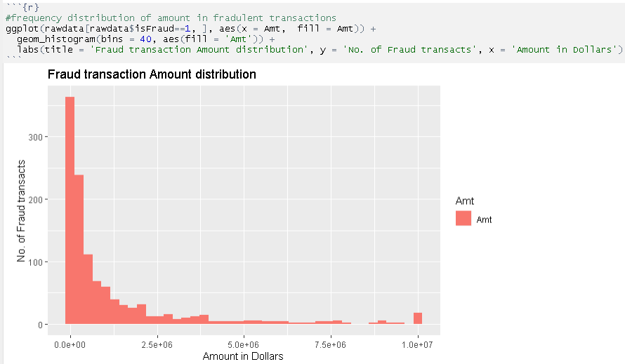
Analyze Dataset
Distribution of Amt feature per class
* Most of the fraud transactions are of lesser amount

Slide 21
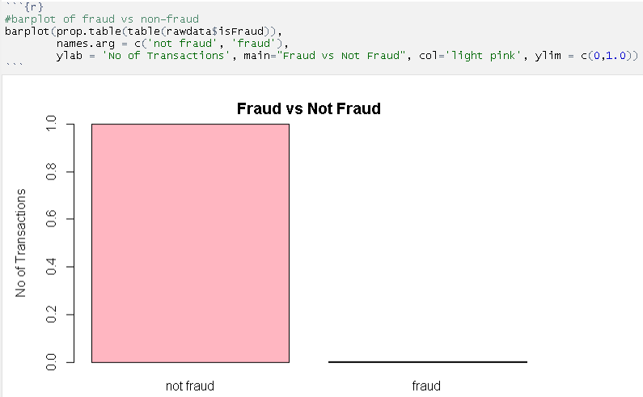
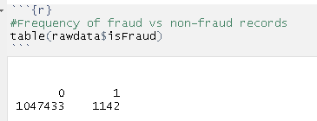
Analyze Dataset
Frequency of fraud vs non-fraud
Proportion of fraud cases versus non-fraud cases

Slide 22
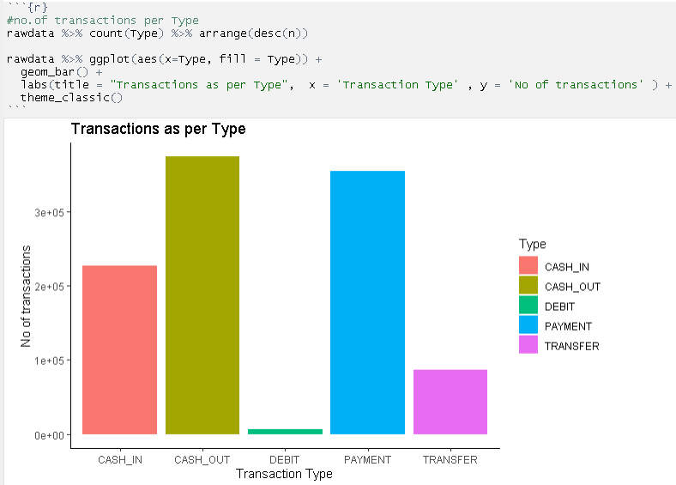
Analyze Dataset
Frequency distribution with respect to TYPE feature

Slide 23
Analyze Dataset
Exploratory Data Analysis (EDA)
Pre-Processing
Data Manipulation
Data Visualization

Slide 24
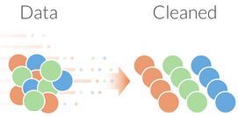
Exploratory Data Analysis
Pre-processing
Data cleansing
Common scale value
Common decimal values
Date format
Duplicates
Detect class imbalance for classification issues
Detect missing values
Fix missing values
Handle outliers

Slide 25


Exploratory Data Analysis
Data manipulation
Filtering
Dropping variables
Creating new variables
Deleting rows
Renaming features
Transforming data
Standardization
Normalization
One Hot Encoding
Binary Encoding

Slide 26

Exploratory Data Analysis
Data Visualization
Scatter plots
Histograms
Pie charts
Boxplots
Bar plots
Pair plots
Violin plots
Density plots
Heatmap plots
Correlation plots

Slide 27
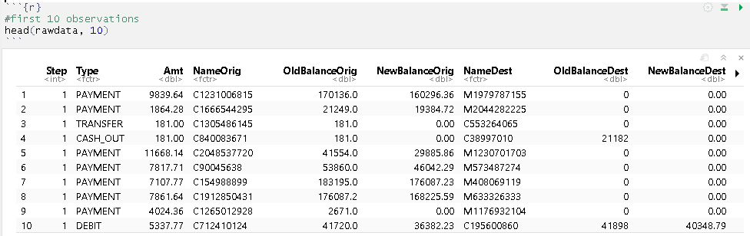
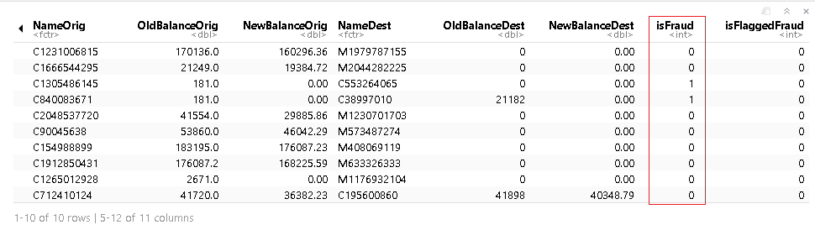
Analyze Dataset
Original dataset

Slide 28
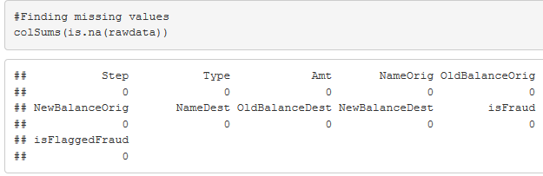
Exploratory Data Analysis
Detect missing value

Slide 29
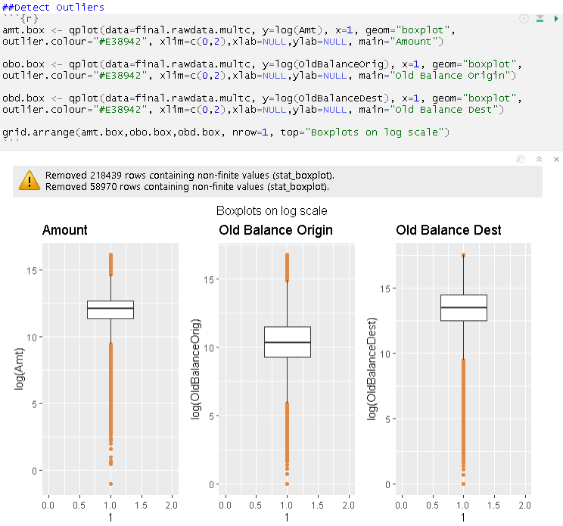
Exploratory Data Analysis
Detect outlier

Slide 30
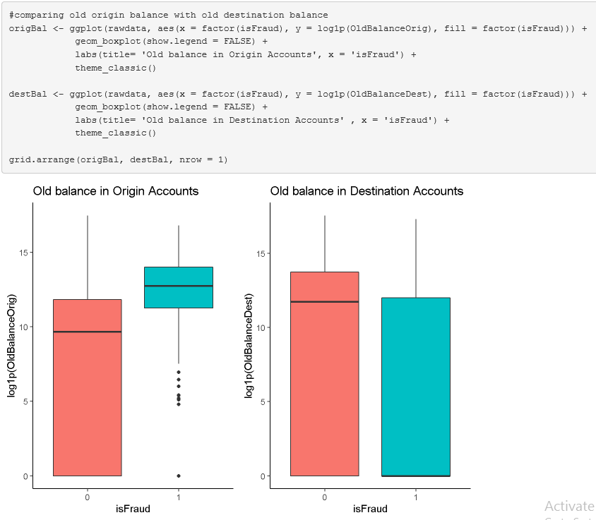
Analyze Dataset
Boxplots

Slide 31
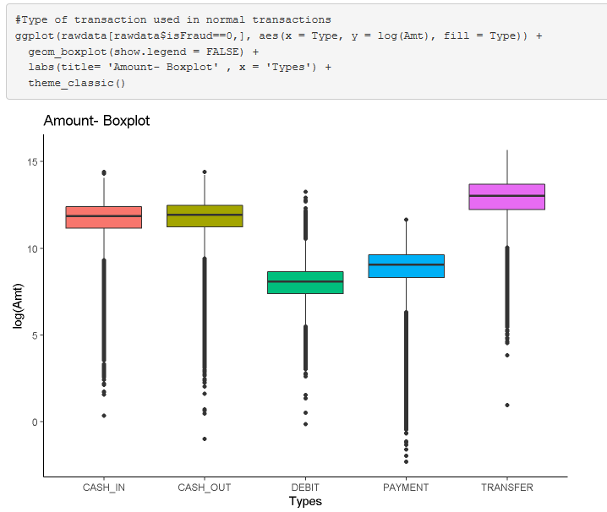
Analyze Dataset
Graphical summaries

Slide 32
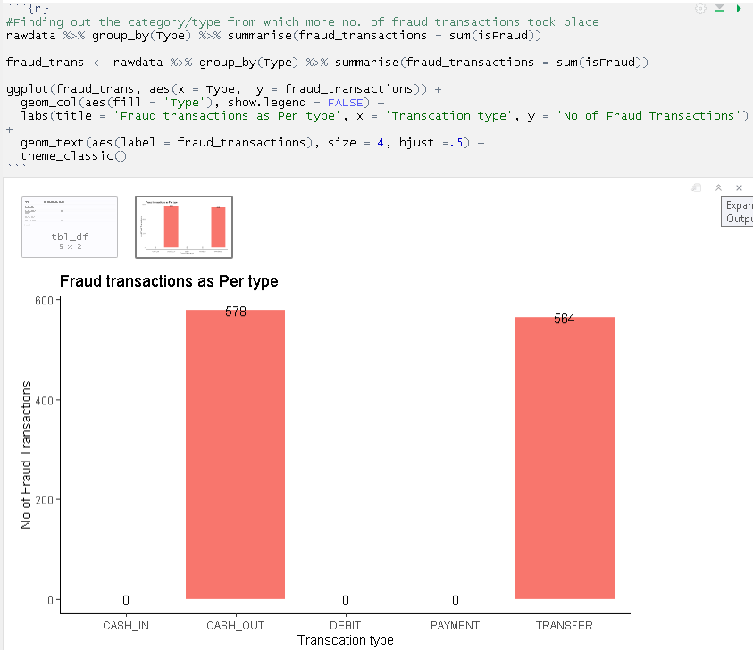
Analyze Dataset
Bar plots
Graphical presentation

Slide 33
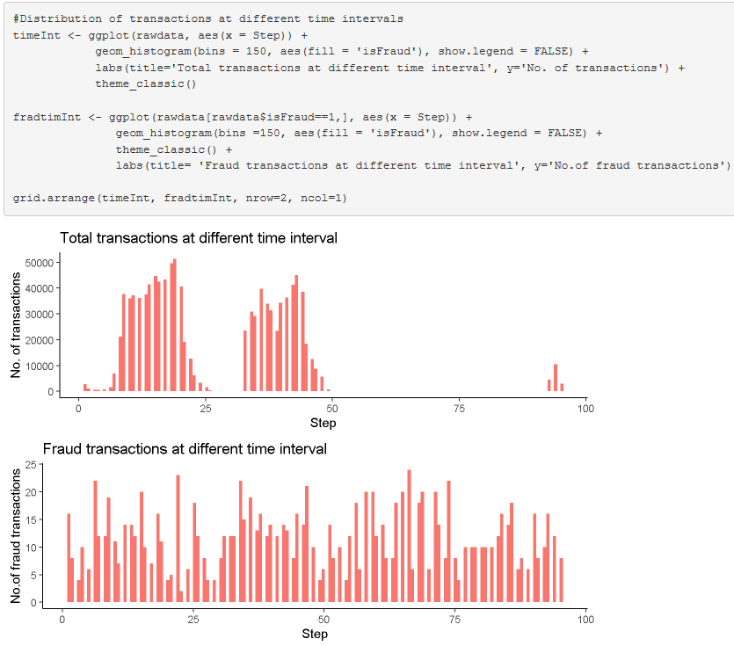
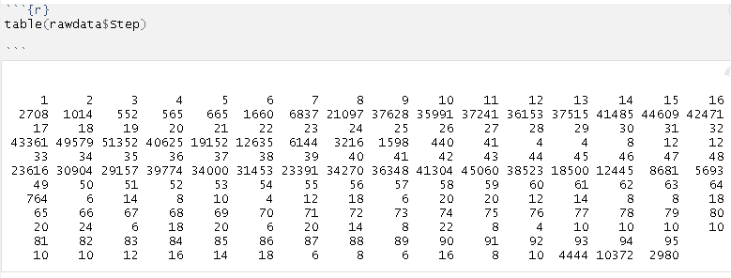
Analyze Dataset
Bar plot of step feature

Slide 34
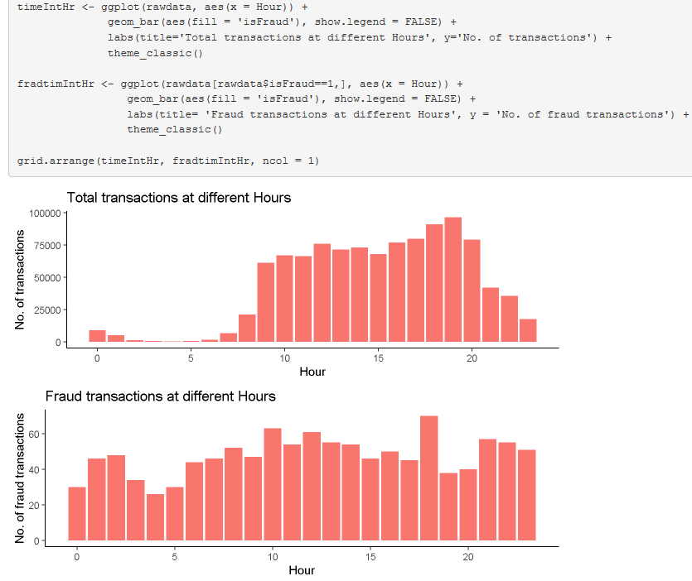
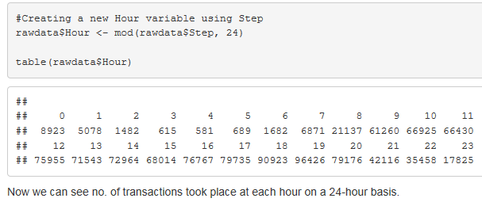
Analyze Dataset
Bar plot after transformation

Slide 35
A few insights discovered:
Most of the fraud transactions are of lesser AMT
Fraud took place only with CASH_OUT and TRANSFER type transactions
TRANSFER type transaction is used in large scale as compared to other types
Fraud transactions took place THROUGHUOT THE CLOCK as compared to legitimate transactions

Slide 36
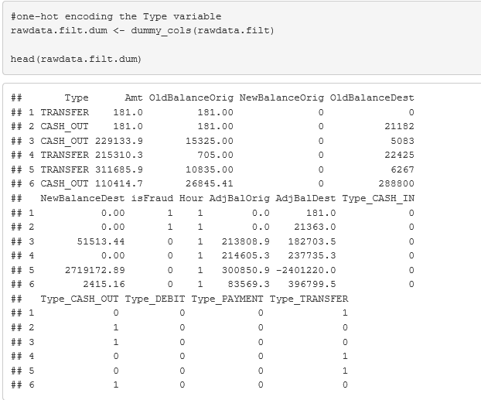
Analyze Dataset
One-hot encoding

Slide 37
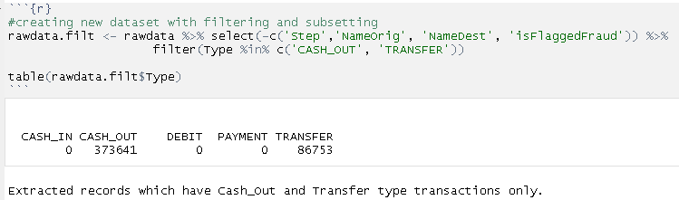
Analyze Dataset
* Eliminating insignificant observations & variables for further analysis

Slide 38
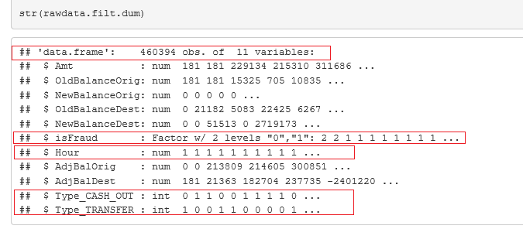
Analyze Dataset
Dataset Structure after EDA

Slide 39

Model Building

Slide 40
Model Building
Feature Engineering
Train Model
Model Validation

Slide 41

Feature Engineering
When your goal is to get the best possible results from a predictive model, you need to get the most from what you have
How do you get the most out of your data for predictive modeling?
Compute information value to find out important variables
You may remove less important features because they are not important for a Machine Learning model to make predictions
Feature importance avoids complexity in the model
Better features means simpler models
Makes optimal utilization of available resources
Reduces cost

Slide 42
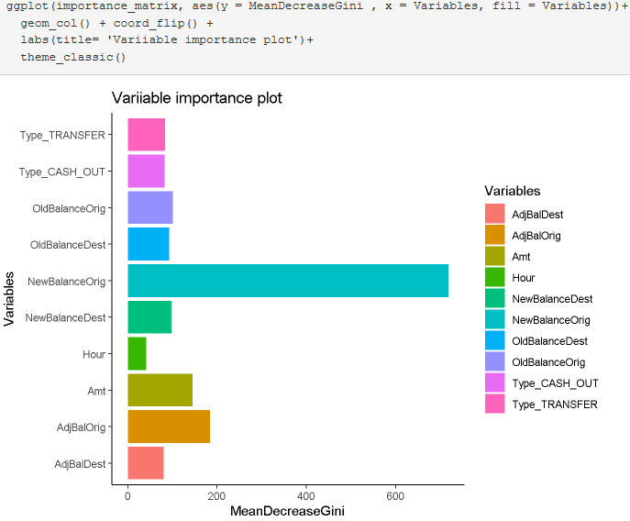
Feature Engineering

Slide 43
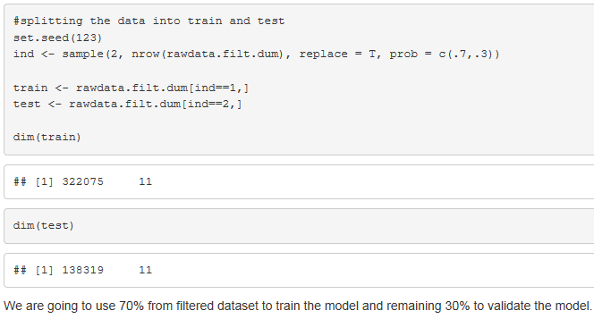
Train Model
Create train and test samples of the dataset

Slide 44
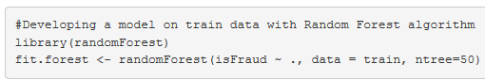
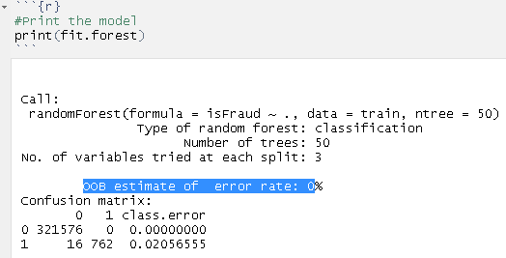
Train Model
Developing model with Random Forest algorithm

Slide 45
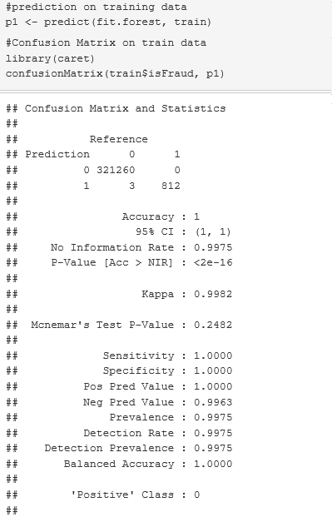
Train Model
Predicting train dataset

Slide 46
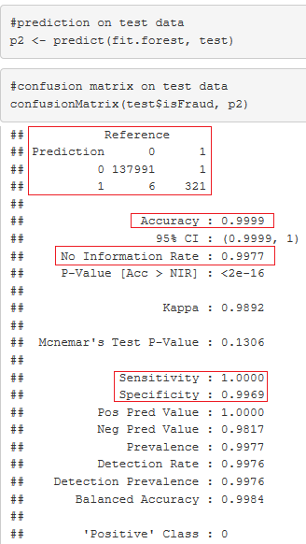
Model Validation
Predicting test dataset

Slide 47

Fine Tuning

Slide 48
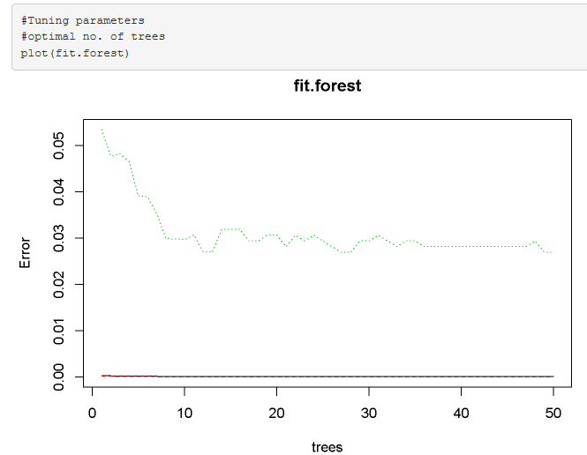
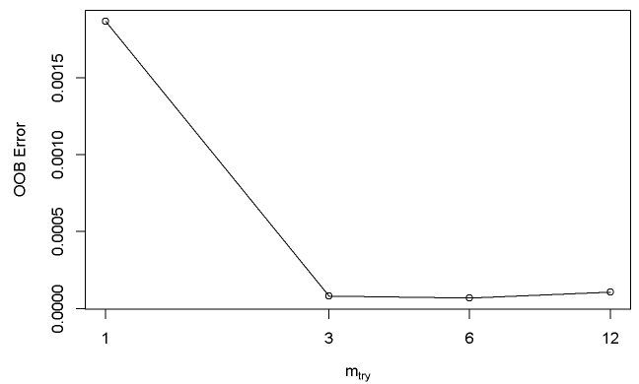
Fine Tuning

Slide 49

Q&A Session

Slide 50
Nagpur
11/1 I.T. Park, Parsodi,
Nagpur - 440022
Ph: +91 712 666 0100
Ph: +1 301 769 6212
Fx: +91 712 664 9845
APAC
10, Anson Road,
#27-08, International Plaza,
Singapore - 079903
Ph: +65 3157 6443
Singapore
unit 08-04, The Signature, Changi Business Park
Thank You
Bengaluru
2nd Floor, Santosh Complex
D.No.1/5, Armugam Circle
Basavangudi,
Bengaluru - 560004
USA
1750 Tysons Blvd, Suite 1500,
McLean, VA 22102
Ph: (703) 289-5117
Fx: (240) 235-4306
United Kingdom
Ph: +44 7746 730 151
Europe & Middle East
34, Chemin Francois-Lehmann,
Grand Saconnex - 1218,
InfoCepts BI App Our iPad Apps and Custom Visualizations that deliver visually appealing graphical displays
www.infocepts.com
Chennai
TIDEL Park Ltd.
Module No-1207/12th Floor,
"D" Block North Side 4,
Rajiv Gandhi Salai, Taramani
Chennai – 600113
Pune
Sky Vista, Ground Floor,
Next to Eminence IT Park,
Airport Road, Viman Nagar
Pune – 411014

Slide 51
Thank You
InfoCepts BI App Our iPad Apps and Custom Visualizations that deliver visually appealing graphical displays
www.infocepts.com

